Slide 1

SVD for face recognition
Evgenii Plyusch, Evgenii Stepanov
BSE181

Slide 2
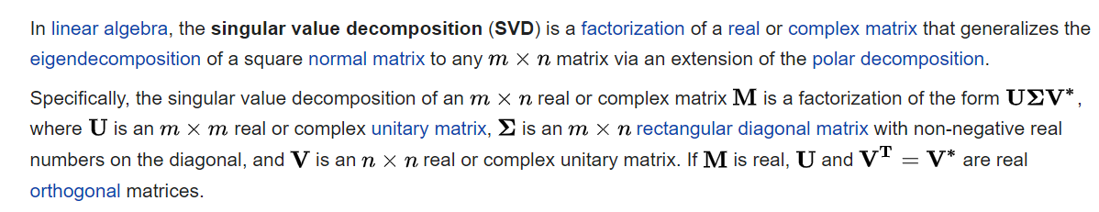
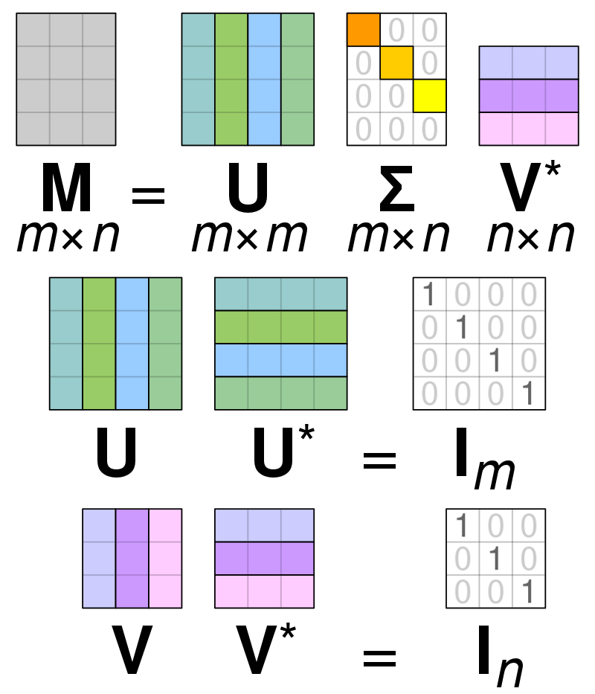

SVD - ?
WHAT IS IT? Just to remind

Slide 3
Our tasks:
1) Make our own implementation of SVD
2) Test it on some small examples
3) Apply SVD to face recognition problem
4) See what will change if we modify (or make zeros) some elements of the $Σ$
4) See what will change if we modify (or make zeros) some elements of the 𝛴

Slide 4
https://github.com/Zhekuson/SVDFaces

Slide 5
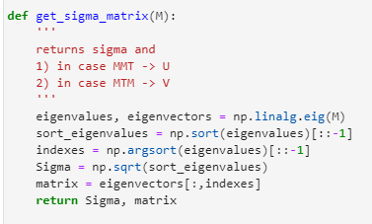
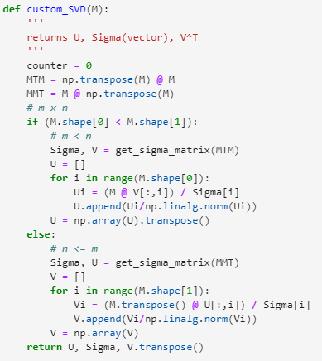
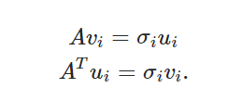
1) Implementation of SVD
Just following our usual algo
We also used some functions from numpy

Slide 6
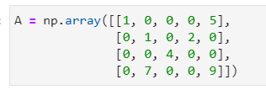

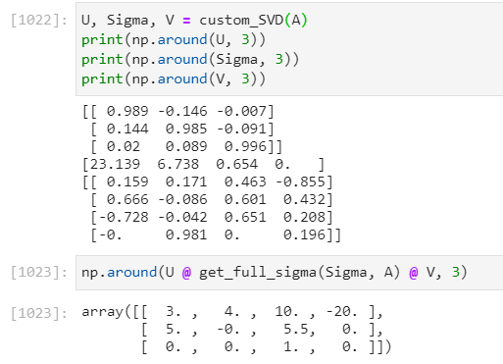
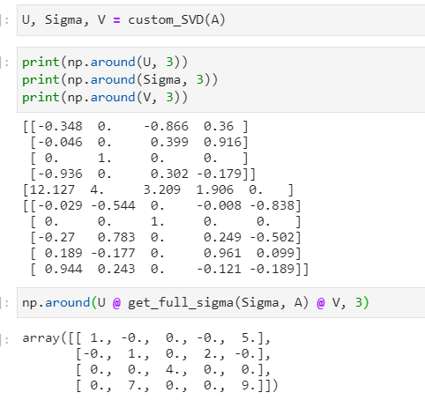
2) Test our SVD (using np.linalg.svd to check)

Slide 7
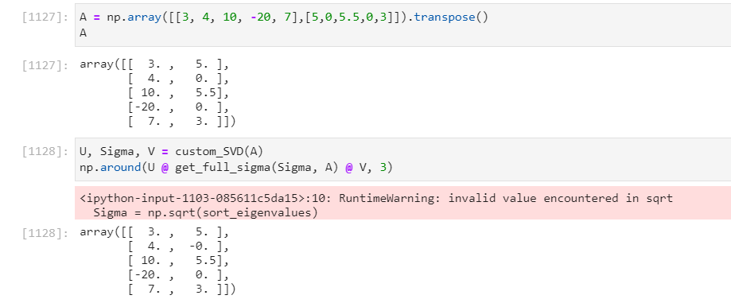

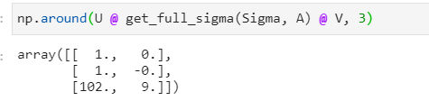

Slide 8
3) Face recognition problem
Some experiments (before us) showed that one condition should be held: faces on images must be located on the same place and images must be the same size
That’s the reason we take an example ORL Faces dataset (little grayscale images in .pgm format)
We also tried face recognition on different datasets (without holding condition), and later we will show you the results

Slide 9
First of all, the best result

Slide 10
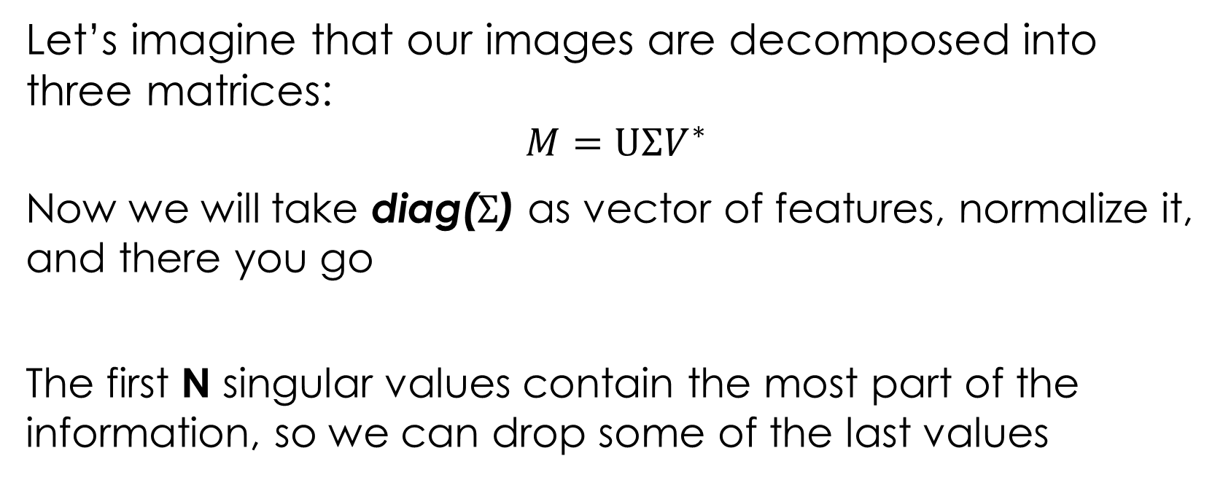
Our hypothesis (👉👈)
Let’s imagine that our images are decomposed into three matrices:
$$M=U{ΣV}^{∗}$$
Now we will take diag($Σ$) as vector of features, normalize it, and there you go
The first N singular values contain the most part of the information, so we can drop some of the last values

Slide 11
Remark: Our method != Eigenfaces
Eigenfaces approach
Our approach
Projections on several subspaces, more data to store
Also, not easy to implement
Save only sigma vector values (several of them) = low memory use
Several lines of code using 2 packages

Slide 12
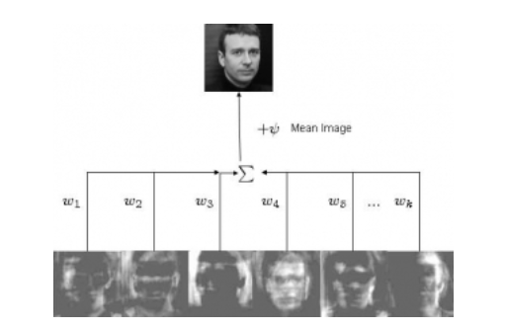
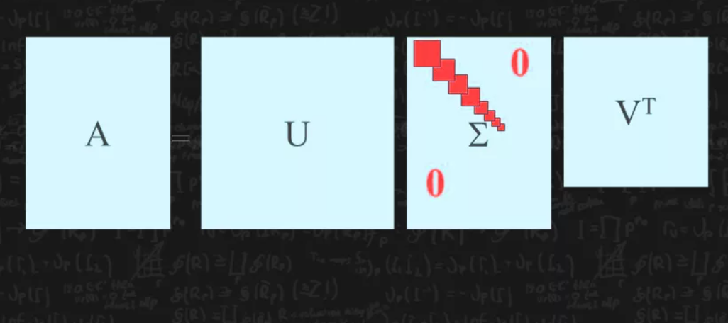

Slide 13
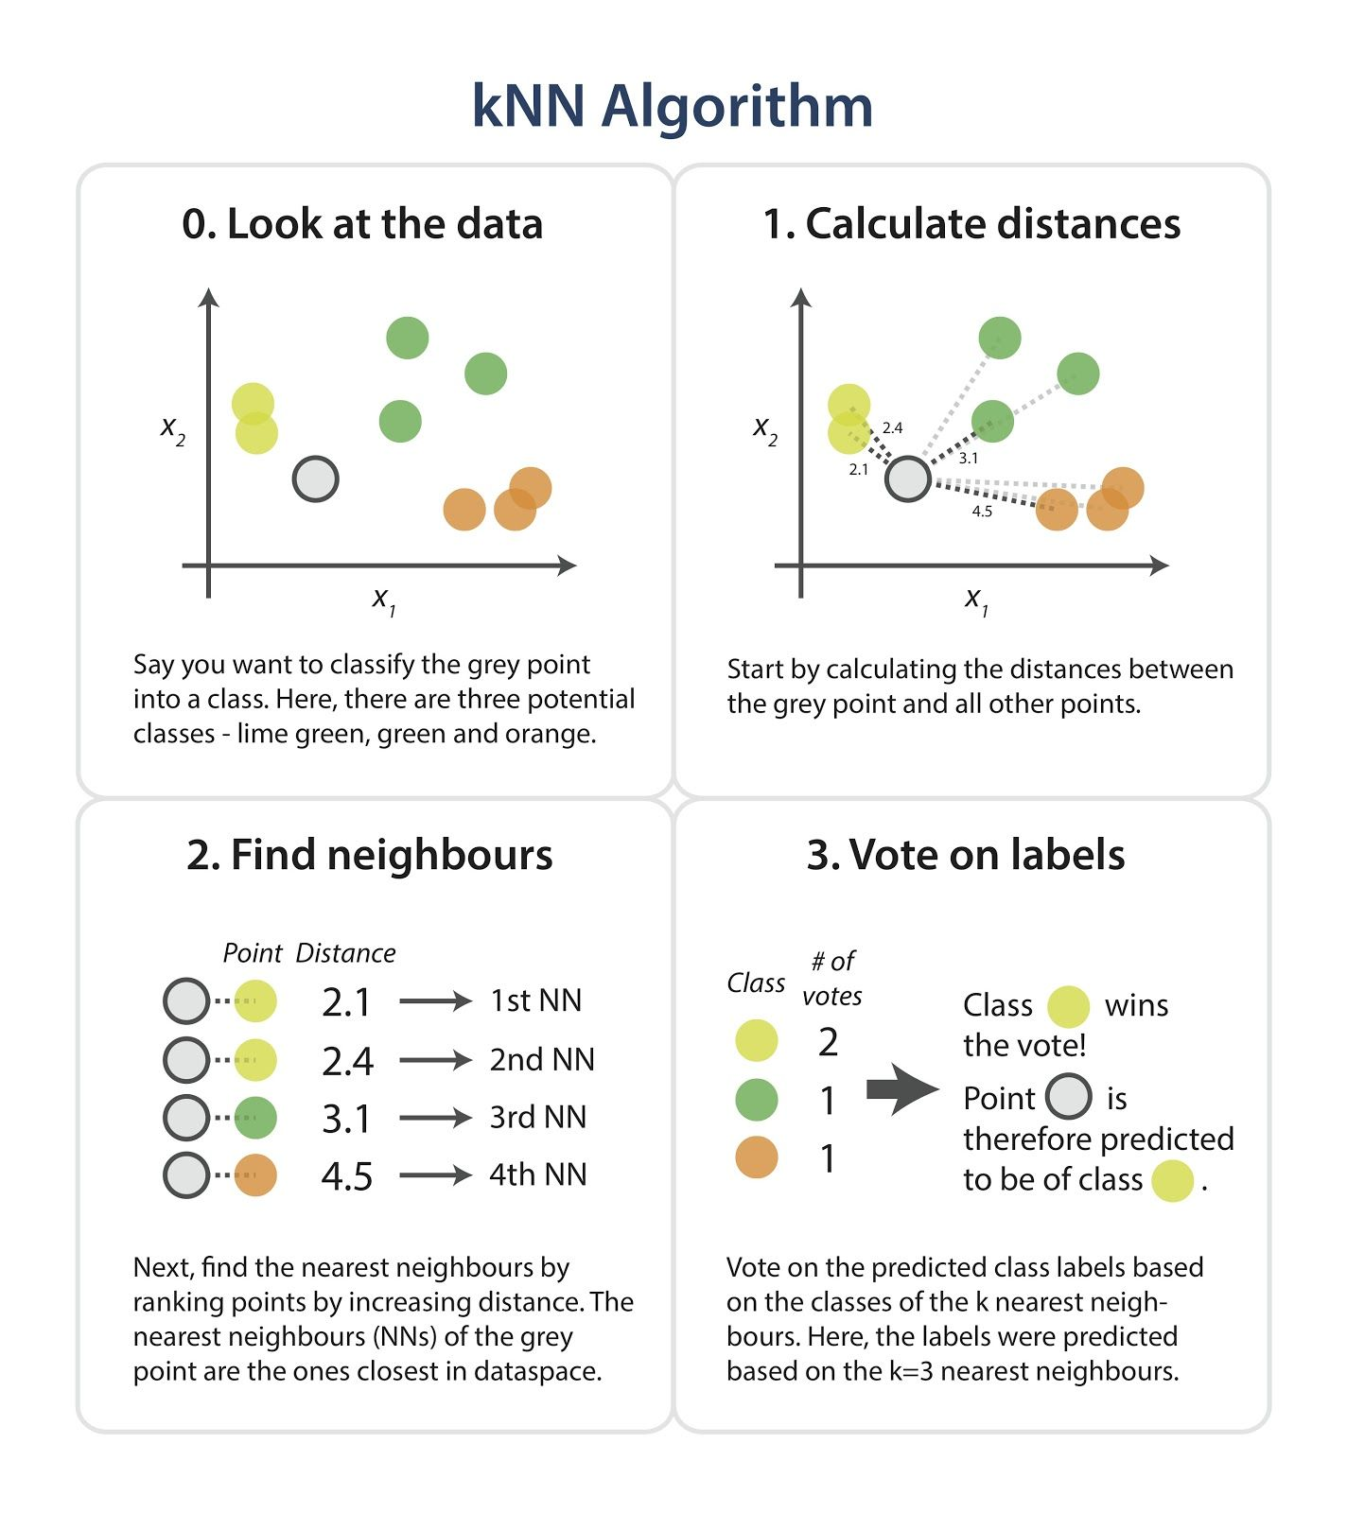
KNN classifier

Slide 14
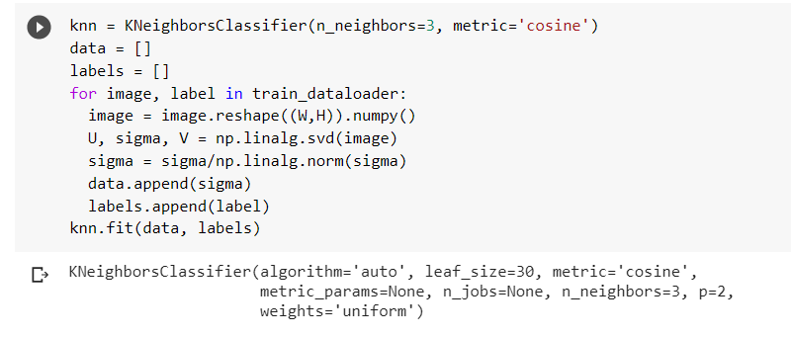
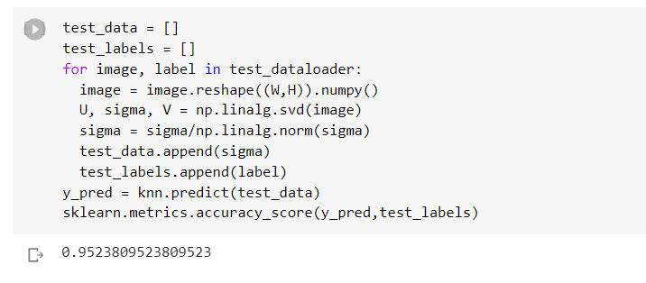
Experiment results
ACCURACY 0.95
Woah!

Slide 15
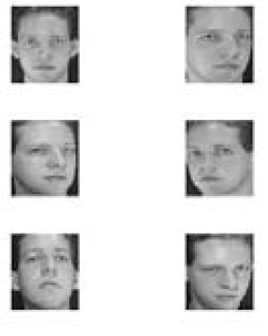
Actually, that was not full ORL
7 classes
21 test images
49 train images

Slide 16
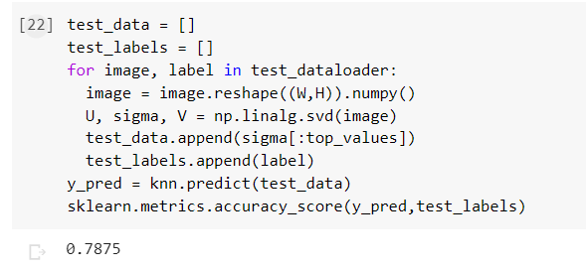
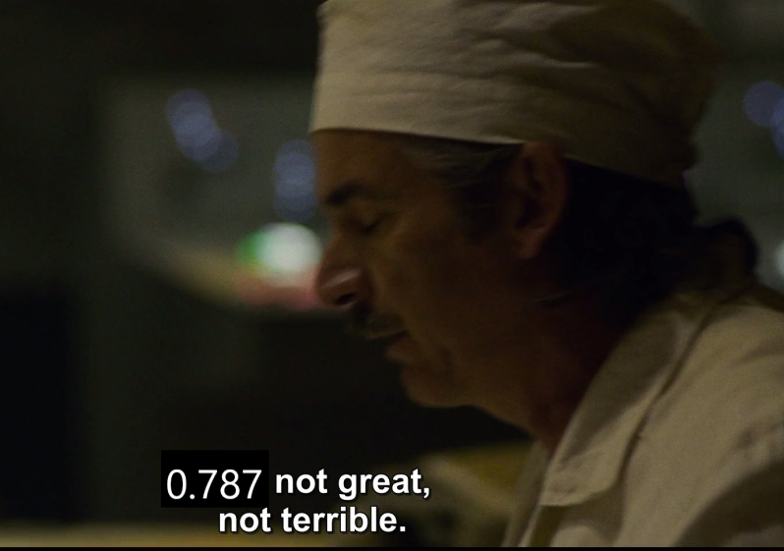
Now with full ORL

Slide 17
And what about other datasets?

Slide 18
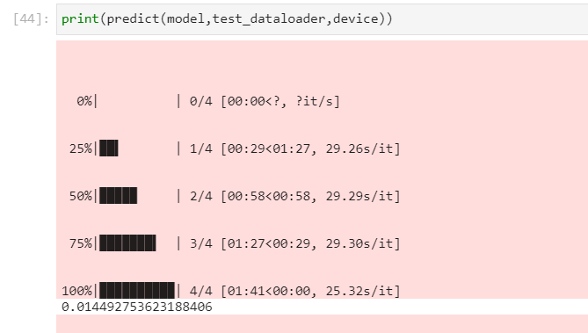
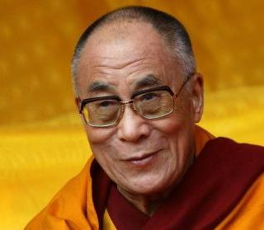
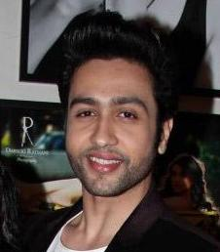
Dataset vgg_face2(little part)

Slide 19
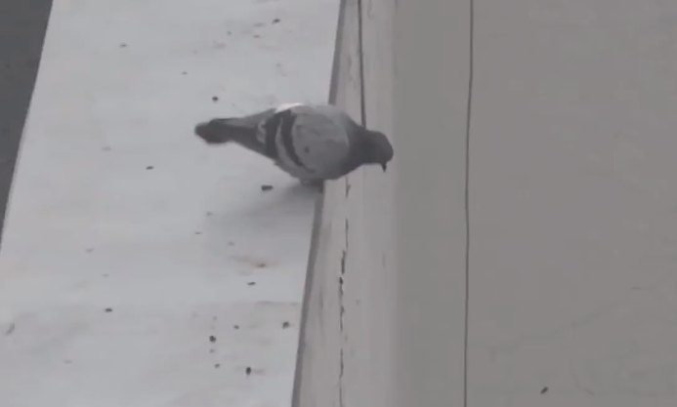
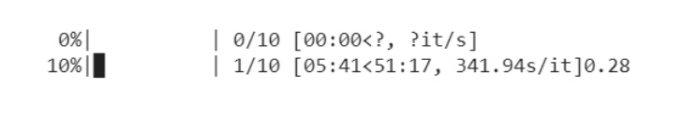
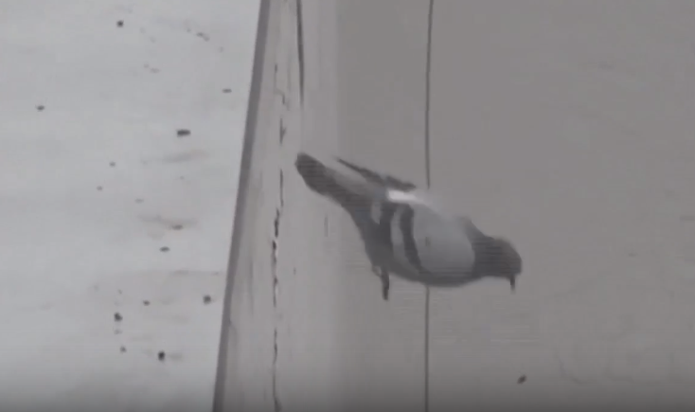

FULL vgg_face2

Slide 20
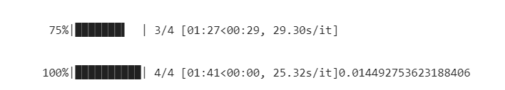

Also, linear models, etc.

Slide 21
Summary
This approach only works on images with same size and same face location
But on these images definitely works great (so cheap to store data and easy to implement)

Slide 22
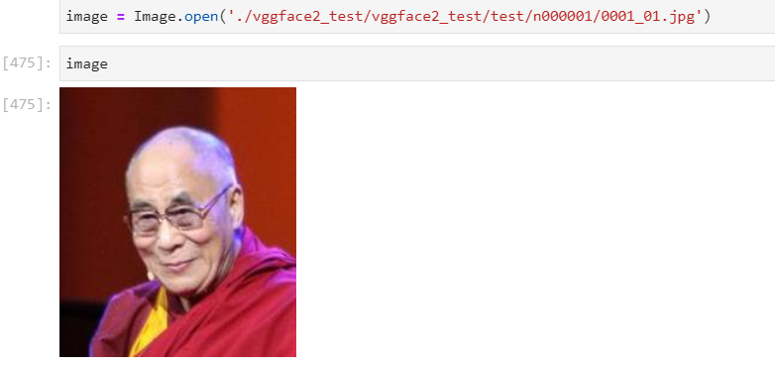
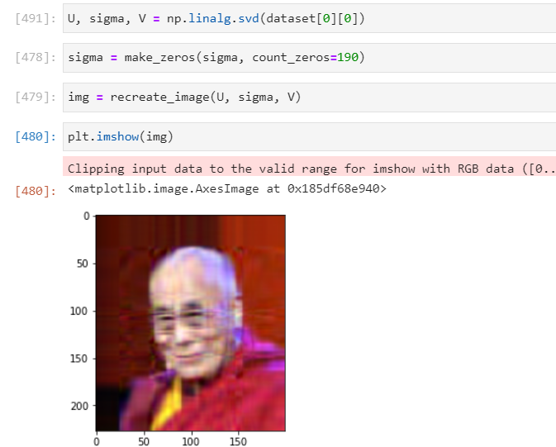
4) Let’s play with eigenvalues

Slide 23
Let’s play with eigenvalues
Put some zeros, starting from the end of sigma matrix
Let’s call count of zeros as “zeros_count”

Slide 24
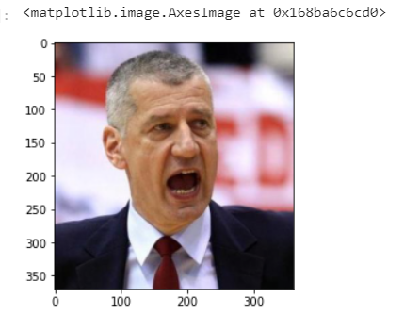
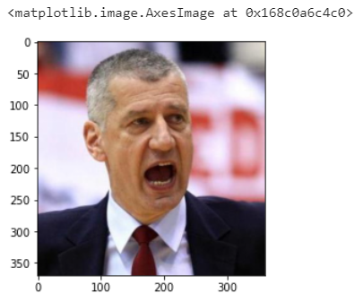
Compare and see
zeros_count = 0
zeros_count = 200

Slide 25
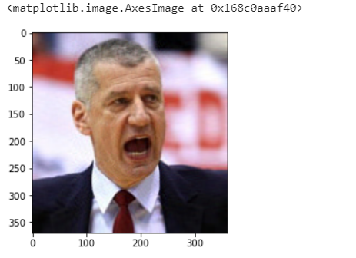
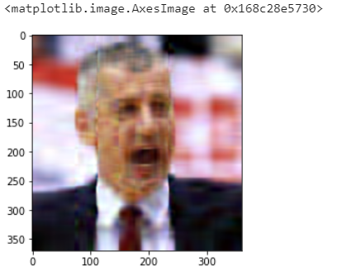
Compare and see
zeros_count = 320
zeros_count = 340

Slide 26
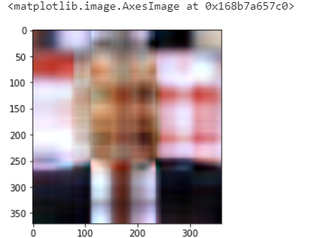
zeros_count = 357

Slide 27
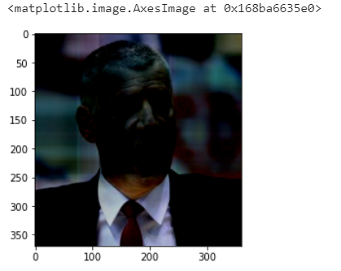
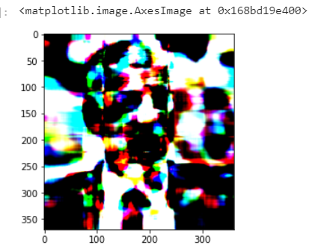
What about changing values?
Changed first singular value to 10 in all channels
Changed first singular value to 1000 in all channels

Slide 28
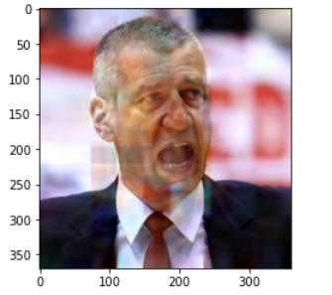
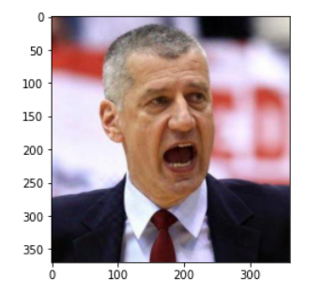
What about changing values?
Changed 5th value to 10
Changed 25th value to 10

Slide 29
Summary
The most important values are located in the beginning of sigma
We can usually truncate up to 90% of singular values and image still will be recognizable

Slide 30
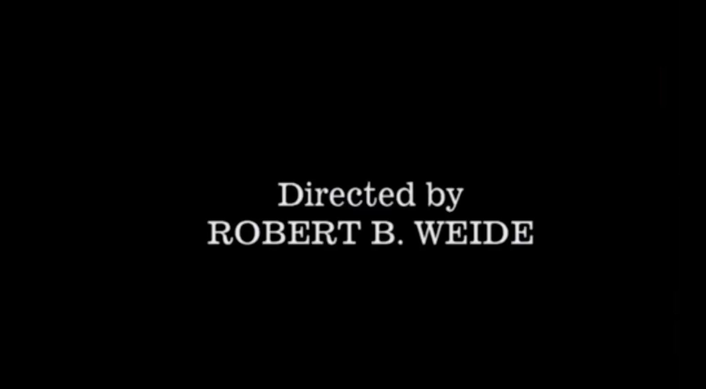
Seems we came to the end… Thanks for your attention!

